Slide 1
Analyze Urban Solar Power market in US
Insight Data Engineering Fellowship, New York
Xiuhong Cai

Slide 2
Motivation
Solar panel market is booming and huge, may reach $22.9 billion by 2025
Not all rooftops are suitable for Solar panels
Target: Help solar companies to target the most potential locations in US
Zip code
Same-time Irradiation
Developable Rooftop

Slide 3







Pipeline

Slide 4
Challenges
How to process a huge file (1.6TB/file) that can’t be loaded automatically to Spark from S3
Using S3fs/H5py, the data is reduced from 14TB to 100MB that can be loaded automatically to spark.
Method | Pros | Cons
Localhost/H5py | Fast | Huge storage for EC2
HSDS, REST API/H5pyd | No storage, Fast | Rate limit
S3fs/H5py | No storage, No Rate Limit | Slowest
Solution: read chunk by Spark -> S3

Slide 5
Challenges
Join Rooftop location and Solar Radiation location
Use Geohash to connect the tow tables
9mins/year
PV Rooftop
Radiation
Geometry | Zip Code
Latitude | Longitude
40.87 -74.00
Centroid
High Accuracy
Slow
Latitude | Longitude
40.8183 -73.9426
dr72
Geohash
Geohash
dr72

Slide 6
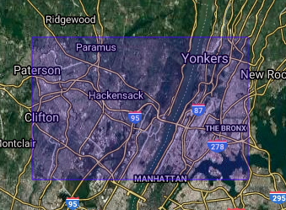
Challenges
Join Rooftop location and Solar Radiation location
Use Geohash to connect the tow tables
2mins/year
PV Rooftop
Radiation
Geometry | Zip Code
Latitude | Longitude
39.1km
40.87 -74.00
19.5km
Latitude | Longitude
40.8183 -73.9426
dr72
Geohash
Geohash
dr72

Slide 7
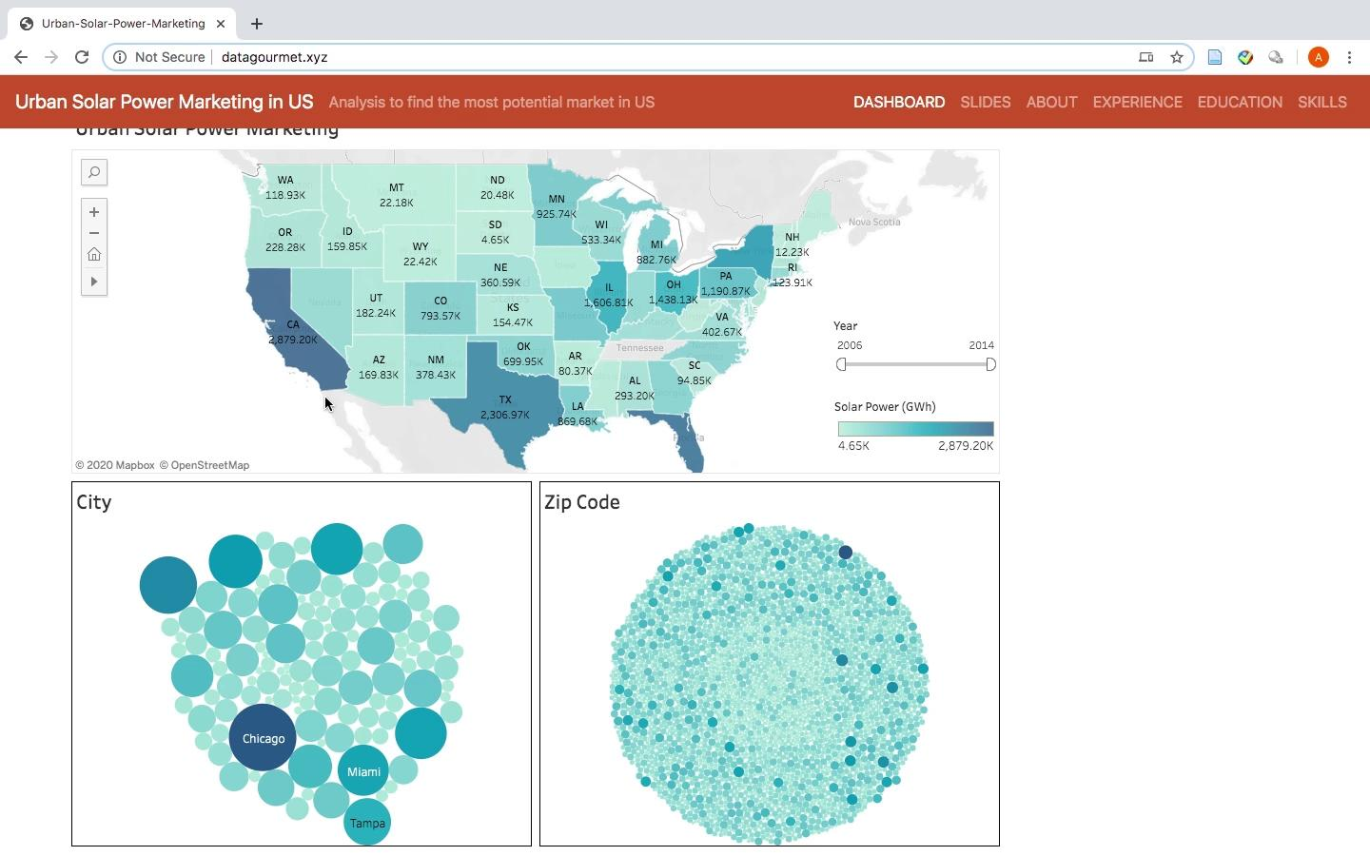
Front End
Tableau

Slide 8
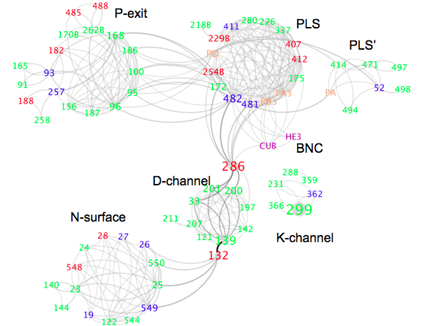




Xiuhong Cai
PhD in Physics
Modeled biology system by classic mechanics
Organized APS CUWIP conference/CSSA leader
Zumba every week

Slide 9


Data
Rooftop information on buildings at 128 metropolitan areas
Solar radiation hourly/half-hourly data in US
PV Rooftop
Solar Radiation

Slide 10




Pipeline
128 metropolitan areas 2006-2014 years
PV Rooftop ~100GB Parquet
Solar Radiation ~14TB HDF5
half-hourly data /location /year

Slide 11
Data Schema
PV rooftop schema Solar radiation data

Slide 12
Future Work
Model of solar power: transfer efficiency,
Electricity usage of residents

